Slide 1



INTERVIEW ai Case bot
Kasturba Bhawan

Slide 2


What does our model do?
Our vision
Our model aims to carry out the task of conducting consulting case interviews wherein it generates questions after scraping paragraphs from case interview books(pdf’s) .
It takes spoken response from the interviewee and analyses them.
If the response contains a certain threshold of keywords, it gives the percentage similarity as output.
In this way, the interviewee can learn and improve the art of giving case interviews by themselves without requiring any external help.

Slide 3

How was it Built?
Dataset creation
Idea
Principle
We extracted relevant pages from case interview book pdf’s using PyPdf2 python library. Then using NLTK we preprocessed the data (features like tokenization, Stopwords removal,lemmatization and punctuation removal were used).
We do webscraping using BeautifulSoup.The model works on LMQG.
LMQG is a Python library designed for generating questions from given text paragraphs using pre-trained language models.
Idea
The keywords obtained were stored in arrays in an excel file .
If the spoken answer contains a certain threshold of keywords, the reply is considered good.
The spoken answer was taken as input through python’s SpeechRecognition library.

Slide 4
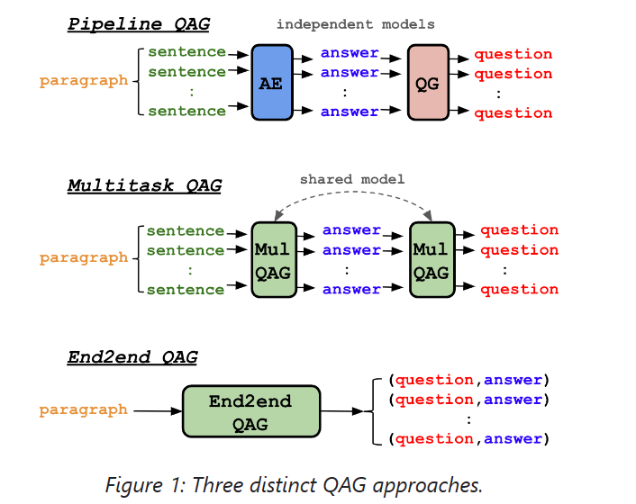

LMQG
Pipeline and Multitask QAG
End2end QAG
End2end model will generate a list of question and answer pairs in an end-to-end manner. In practice, Pipeline and Multitask generate more question and answer pairs, while End2end generates less but a few times faster.
it consists of question generation (QG) and answer extraction (AE) models independently, where AE will parse all the sentences in the context to extract answers, and QG will generate questions on the answers.

Slide 5
Challenges faced
We explored pretrained models such as BERT and Ragflow earlier but decided that LMQG is the best fit for our idea. Thus,it took us time before we finally reached to a conclusion about which pretrained model to use.
Splitting of text into questions and answers while creating the dataset was done manually which took a significant amount of time. This was before we used LMQG.
We faced issues while deploying the project on streamlit.

Slide 6
ERROR analysis
Since we used only LMQG ,there wasn’t a need to calculate F1 score or do hyperparameter tuning for this project. However, we have calculated similarity score for this which is an evaluation metric for our model.
Furthurmore , if the similarity score is less than a certain threshold ,our model suggests an appropriate answer, thereby facilitating a more efficient learning process.

Slide 7
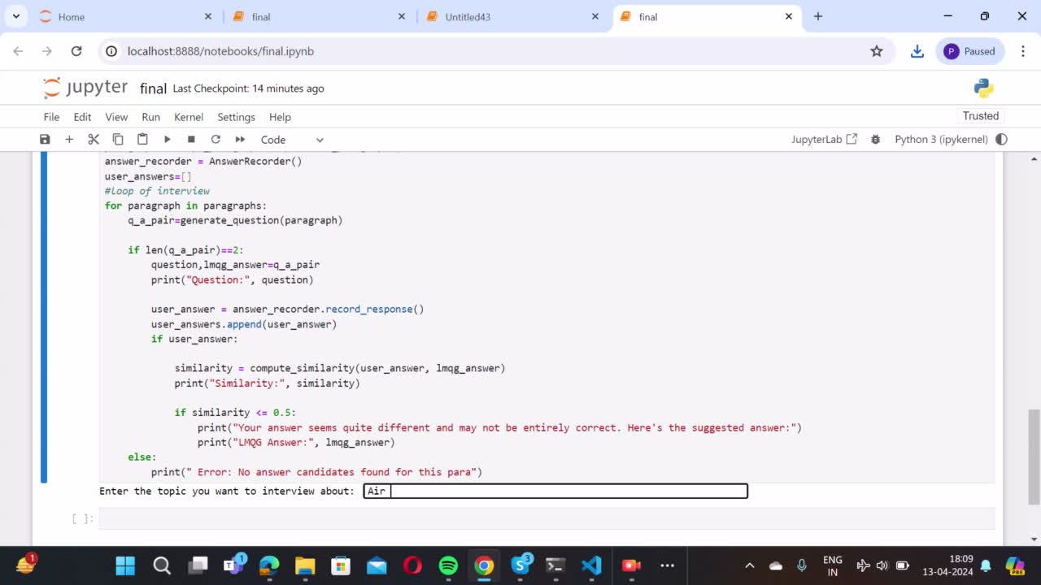

Slide 8
Thank
you!

